Slide 1

QUB EEECS CSC4006: RESEARCH AND DEVELOPMENT PROJECT
Adaptivity in Stateful Parallel Pattern
Final Presentation
Tianbai Peng <tpeng01@qub.ac.uk>
EEECS, Queens University Belfast
Supervisor: Peter Kilpatrick

Slide 2
Outline
Introduction
Adaptivity
-Definition
Stateful Access Pattern
-Definition
-The stateful dataset in Fastflow project
Fastflow
-Introduction
-Pattern and the Algorithm skeleton
-Core pattern in Fastflow
Adaptivity in Stateful Parallel Pattern
-purpose
-a example how the program works
-performance

Slide 3
Introduction
Free lunch is over
-Think about parallel programming
Programming with the parallel framework
-Such as TBB,MPI ,OPENMP, AMP,PPL…
Stateful tasks still account for a large proportion
Applying adaptivity to the execution of stateful tasks has become a top priority in the area of parallel programming

Slide 4
Adaptivity
The definition
Adaptivity is the process of automatically adjusting the processing method to obtain the best processing effect according to the data characteristics of the processed data during processing.
Adaptivity in the Fastflow Application
The number of workers will be automatically adjusted to make better use of the CPU.

Slide 5
Stateful Access Pattern
The definition
As patterns where the stage (in pipeline) or the worker (in farm) processes/threads should support
internal state and support access to some more generalized notion of “pattern” global state.
The stateful dataset in our project
Bank account transaction example: imitating the process of bank account transactions,

Slide 6
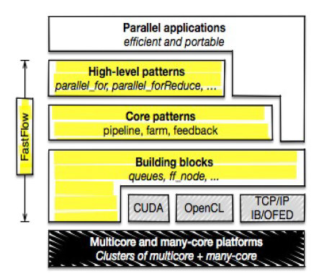
Fastflow
Introduction
Fastflow is a C++ high-efficiency parallel framework , which advocating high-level, pattern-based parallel programming.
Performance
After a rigorous assessment, FastFlow is typically faster than some state-of-the-art parallel programming frameworks such as Intel TBB, OpenMP, Cilk in some cases

Slide 7
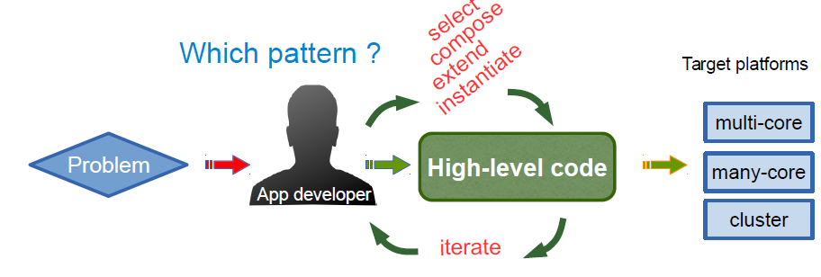
Fastflow
Pattern and the algorithm skeleton
Parallel design pattern
“Recipes“ to handle parallelism
(name, problem, algorithms,
solutions, ...)
algorithm skeleton
Pre-defined parallel high-order functions provided as constructs or lib calls

Slide 8
Fastflow
Core pattern in Fastflow
pipeline: computes F4(F3(F2(F1(x)))) for each x
– Pipeline computing elements are called stages
F1
F2
F3
F4
task-farm (or farm), models functional replication
– Sometimes called also “master-worker”
– Computing elements called: Emitter (E), Worker (computing F) and Collector (C)
– The Emitter, schedules tasks towards the Workers
– The Collector, gathers tasks from Workers
We mostly used task-farm pattern in this final project
Worker
Emitter
Collector
Worker

Slide 9
Adaptivity in Stateful Parallel Pattern
Purpose
Through adding the adaptivity function to process the stateful tasks, to make sure the average consumption is always keep in the specific range .And we also observe the performance of adaptivity each different stateful percentage.
Approach
by recoding the during time between recent 10 tasks, and we set the specific total workers and some workers active at the begin, then if the consume larger than specific period, we need the adaptivity, so the active workers add 1 during every 10 tasks, if the consume less than specific second, that means we don’t need the adaptive, so the active workers reduce 1 during every 10 task .

Slide 10
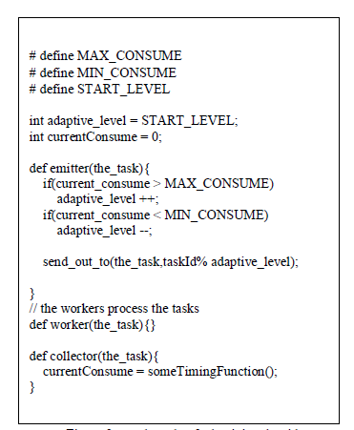
Adaptivity in Stateful Parallel Pattern
Approach(continue)
About adaptivity algorithm

Slide 11
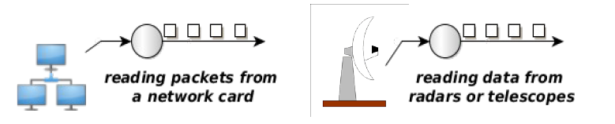
Adaptivity in Stateful Parallel Pattern
Input data
-in this project we used ‘fake stream’
“real streams“
– In these cases it is really important to satisfy minimum processing requirements
(bandwidth, latency, etc...) in order to not lose data coming from the source
“fake streams”: streams produced by unrolling loops
– You don't have an “infinite“ source of data
– The source is a software module

Slide 12
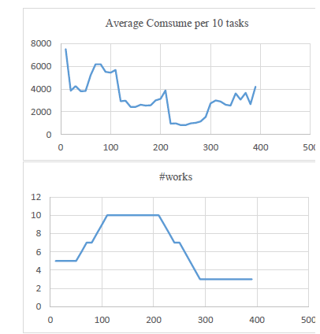
Adaptivity in Stateful Parallel Pattern
a example how the program works
The example is the adaptivity with 1% stateful tasks from the paper, the controlled experiment consumption range is from 2000ms to 5000ms per 10 tasks.
And I set first 50 tasks are normal tasks which cost 4000 around per 10 tasks at 5 workers, 50~100 are hard tasks, and 200~400 are easy tasks .

Slide 13
Adaptivity in Stateful Parallel Pattern
a example how the program works
the Emitter send tasks to 5 Workers at the beginning

Slide 14
Adaptivity in Stateful Parallel Pattern
a example how the program works
because the average consume still not more than 5000ms,so the number of active Workers keep at 5

Slide 15
Adaptivity in Stateful Parallel Pattern
a example how the program works
in the task number 50~100, we used hard task which takes more time, therefore the average consume would be over 5000ms, Emitter start send tasks to a new worker, and number of active Workers automatically increase 1

Slide 16
Adaptivity in Stateful Parallel Pattern
a example how the program works
although the number of Workers has been increased, the average consumption still higher than 5000ms, so that active Worker counts keeps increase

Slide 17
Adaptivity in Stateful Parallel Pattern
a example how the program works
with the number of active Workers increase to 10,the process speed has got quickly enough ,therefore the average consumption back to around 3000, then number of active Workers keep at 10

Slide 18
Adaptivity in Stateful Parallel Pattern
a example how the program works
after task number 200, we instead all the tasks by the easy task, therefore the average consume would be less than 2000ms,we don’t need so many workers at this time ,emitter stop send tasks to a exist active worker, and number of active Workers automatically reduce 1

Slide 19
Adaptivity in Stateful Parallel Pattern
a example how the program works
with the number of active Workers reduce to 3,the process speed has got slowly, therefore the average consumption back to around 3000, then number of active Workers keep at 3 all the time.

Slide 20
Adaptivity in Stateful Parallel Pattern
The performance
-the adaptivity may not be very well with the high percentage stateful.
Future work may focus on the scheduling algorithm and using the real stream.

Slide 21
Q&A

